Slide 1
Linking Assessment to Housing and Outcomes Preliminary Results using the NST Tool
Eric Rice

Slide 2
Prioritization
Not enough housing for everyone who needs it?
So who should get high intensity services?

Slide 3
Learning from Million Dollar Murray
Tools for homeless adults identify and prioritize based on fragility of health or costs incurred to public health systems.
Youth are relatively healthy and generally haven’t incurred extensive health care system costs.
Notes:
ER

Slide 4
How was the TAY Triage Tool developed?
CSH partnered with a local university professor for data collection, analysis, and tool creation.
Public and private stakeholders shaped the development of the tool.
646 Homeless Youth Surveys
2 Community Advisory Bodies
6 TAY PSH Site Visits
Dr. Eric Rice,
Associate Professor,
University of Southern California,
School of Social Work
Photo courtesy of Dr. Eric Rice
Notes:
ER

Slide 6
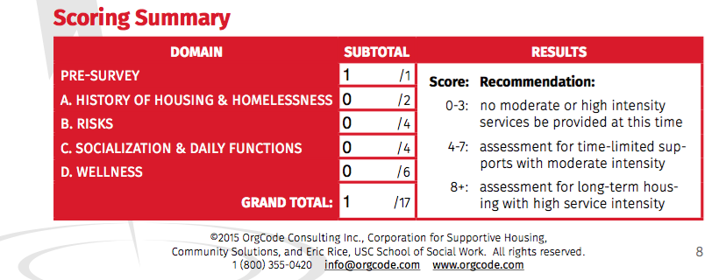
There is NO research supporting this scoring system.
NONE. …yet?

Slide 7
Risk
Housing
Success

Slide 11
Predictors of PSH Success
Multivariate Logistic Regression of Housing Stability Given PSH Outcome
 | PSH Exits (N=579)
 | OR |  | 95% CI
Demographics
17 or Younger | 1.60 |  | [0.81, 3.14]
Female | 0.85 |  | [0.49, 1.49]
LGBTQQI2 | 0.94 |  | [0.6, 1.48]
Black | 0.83 |  | [0.51, 1.35]
Hispanic | 0.78 |  | [0.38, 1.59]
Trauma History/Risk
Unhealthy or Abusive relationship | 0.60 | * | [0.37, 0.95]
Final Acuity Score | 0.74 | *** | [0.65, 0.86]
-2 Log Likelihood | 513.90
Note: *p<.05; **p<.01; ***p<.001

Slide 12
Predictors of RRH Success
Multivariate Logistic Regression of Housing Stability Given RRH Outcome
 | RRH Exits (N=2885)
 | OR |  | 95% CI
Demographics
17 or Younger | 0.64 | *** | [0.51, 0.79]
Female | 1.12 |  | [0.88, 1.43]
LGBTQQI2 | 1.19 |  | [0.96, 1.48]
Black | 0.72 | ** | [0.58, 0.9]
Hispanic | 0.68 | ** | [0.52, 0.90]
Living Situation
Couch | 0.11 | *** | [0.07, 0.18]
Transitional Housing | 0.12 | *** | [0.10, 0.15]
Trauma History/Risk
Final Acuity Score | 0.78 | *** | [0.72, 0.84]
-2 Log Likelihood | 2667.74
Note: *p<.05; **p<.01; ***p<.001

Slide 13
Recommendations
Move PSH up to 10 – RRH works great for 8-9 – HUGE cost savings!
Some additional experimentation with RRH for 10+ (only 25 out of 10,922 tried)
Must figure out who of 4 or under is not exiting on their own and provide resources

Slide 14
Caveats
No sense of time
No TLP exits included
No service delivery included
No sense of how RRH is used (6, 12, 18 months)
No sense of scattered site vs. congregate living
MUCH still to be done!!!

Slide 15
You’re still homeless. You’re still homeless so it’s like that’s the… No matter what these questions don’t change the homeless to a capital “H” homeless: You’re a capital “H” homeless. You’re not a lower case “homeless”. You’re a capital “H” homeless. You’re still fucking homeless. Excuse my language.

Slide 16
Thank you to the Youth!
Paper to come out in Cityscape in fall.
Brief report available on “publications” tab at CAIS.USC.EDU or
https://www.cais.usc.edu/wp-content/uploads/2018/02/Rice-Assessments-and-Outcomes.pdf

