Slide 1

Pathways to Homelessness among Older Homeless Adults
Margot Kushel, MD
Professor of Medicine, UCSF
@mkushel

Slide 2
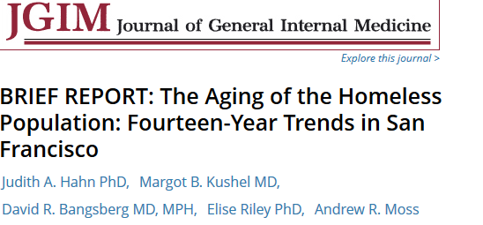
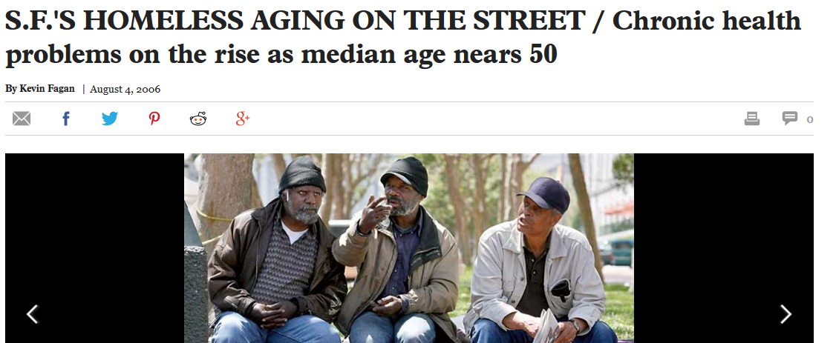
The homeless population is aging
        Proportion of single homeless adults ≥50 in San Francisco
        1990 11%
        2003 37%
        Today ??
        Median age increased 0.66 years for every calendar year between 1990-2003
Hahn J et al. The Aging of the Homeless Population JGIM 2006

Slide 3
Generational effect
Americans born in the second half of the baby boom (1954 - 1963) have had elevated risk of homelessness throughout their lifetime
*doesn’t include people living in homeless families or unaccompanied youth
Dennis P. Culhane, Stephen Metraux, Thomas Byrne, Magdi Steno, Jay Bainbridge, and National Center on Homelessness among Veterans. "The Age Structure of Contemporary Homelessness: Evidence and Implications for Public Policy" Analyses of Social Issues and Public Policy 13.1 (2013): 1-17.
Notes:
Late baby boomers came of age in times of depressed wages, high unemployment for young adults, and high rental housing costs
Crack cocaine epidemic (when these came of age)—increased likelihood of involvement in drugs (SUD and dealing)—loss of employment and increased risk incarceration
Changes in criminal justice policies—increased risk of prolonged incarceration
Erosion of safety net in 1980s and 1990s

Slide 4
HOPE HOME Study
Health Outcomes of People Experiencing Homelessness in Older Middle agE
  Funded by National Institute on Aging (NIA)
  Longitudinal cohort study in Oakland, CA
  350 participants enrolled July 2013 to June 2014, following participants every six months
  Renewed for another five years

Slide 5
HOPE HOME Study
Study activities take place at St Mary’s Center, East Bay Community Recovery Center, and Allen Temple
Active Community Advisory Board
  Local leaders (service providers, clinicians, policy experts, etc.)
  Three study participants
Study includes:
  Regular study interviews and exams
  Qualitative interviews on topics of interest
  Ability to add new questions/adapt study

Slide 6
HOPE HOME Study
Aged 50 and older
English speaking
Homeless by HEARTH Act definition at time of enrollment
  Living outdoors, places not meant for human habitation
  Emergency shelters
  Losing housing within 14 days (eviction notice)
  Fleeing domestic violence with no place to go

Slide 7
Methods: Baseline Interview
Lengthy baseline interview
  Life course history (below 18, 18-25, 26-49, 50+)
    history of homelessness
    adverse childhood events
    social support
    employment
    education
    health and mental health problems
    substance use problems
  “Target Year” (last year stable housing)
    Precipitants of homelessness

Slide 8
Methods: Baseline Interview
  History of homelessness
  6 month residential calendar
  Food insecurity and benefits
  Employment, Veteran Status, Criminal Justice
  Social Support

Slide 9
Baseline Interview: Methods
  Health
    Self-rated
    Chronic diseases
    Functional status (ADL, BIFS)
    Oral health, Pain, Traumatic Brain Injury

Slide 10
Methods: Baseline Interview
Mental Health
  CES-D
  PTSD-PC
  ASI (anxiety, hallucinations, suicidality)
Substance Use
  ASSIST (cocaine, opioids, methamphetamine, MJ)
  AUDIT
  California Tobacco Survey

Slide 11
Methods: Baseline Interview
Health Services Utilization
  Emergency Department (reviewed records)
  Inpatient hospitalizations (reviewed records)
  Primary Care
  Dental Care
  Mental Health Care (outpatient, ED, hospitalization)
  Substance Use Treatment

Slide 12
Methods: Clinical Assessments
  Cognitive impairment (3MS, Trails A and B, Grooved Pegboard)
  Mobility (Short Physical Performance Battery)
  Body Mass Index
  Visual acuity

Slide 13
6 month follow up interviews and monthly check-ins
Follow-up interviews
  Shorter, focus on interim history—include domains from baseline
  Add items (Violence, smoking quitting behaviors, sexual behaviors and identity, cell phone and internet usage/interest, Advance Care Planning, Symptoms, Encampments etc)
  Clinical Assessments
Participants check in monthly (in person or by phone) to maintain contact with study
Check death records, coroners, jail records
Follow-up rates: About 80% each visit; 90%+ had at least one follow-up; 54% completed ALL seven interviews for first three years

Slide 14
Qualitative
In-depth interviews about different topics (life course, symptoms, advance care planning, and large qual and ethnographic study (separate R01) about family relationships and housing with family)
24 life course interviews
  12 participants first homeless prior to age 50
  12 participants first homeless age 50 or later
  Open ended
    Life course review
    Early childhood, early adulthood, mid life, late life
    Focus on first homelessness episode, most recent homelessness and precipitants
  Coded
  Generated Themes
  Comparison by age at first homeless

Slide 15
Life Course Experiences Study
Life course experiences during each critical life period (<18, 18-25, 26-49, 50+)
Current vulnerabilities
  Incarceration
  Self-reported health status
  Mental health and substance use
  Functional and Cognitive Status
Descriptive statistics
  First homeless <50 vs 50 or older

Slide 16
Life course analysis modelling strategy
Outcome: First homelessness episode before age 50
  Created four models for each variable
    3 models, dichotomous variable each life course period
    Model with dichotomous term for all 3 periods
    Model w 3 dichotomous term plus interaction term
    Model with cumulative score for how often experience (0,1,2,3)
Chose best fitting model for each variable (bivariable)
After selecting best fit for each variable, entered into multivariable model (p<0.2; backward elimination p<0.05)

Slide 17
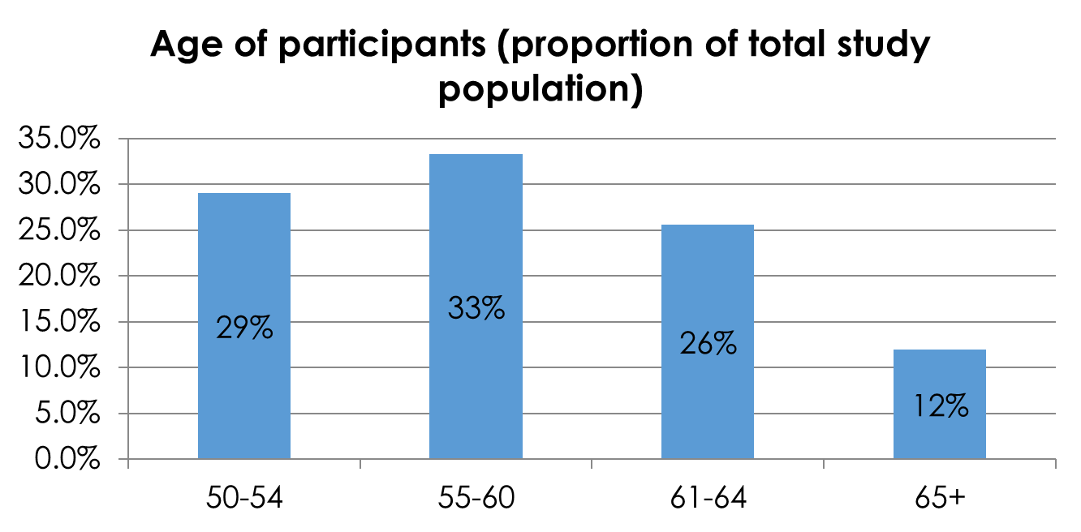
Two thirds are 60 and under, but 12% are older than 65 years at study entry: Median age 57

Slide 18
Study population
77% men
80% African American
13% currently work for pay
28% currently looking for work
90% income less than $1150/month

Slide 19
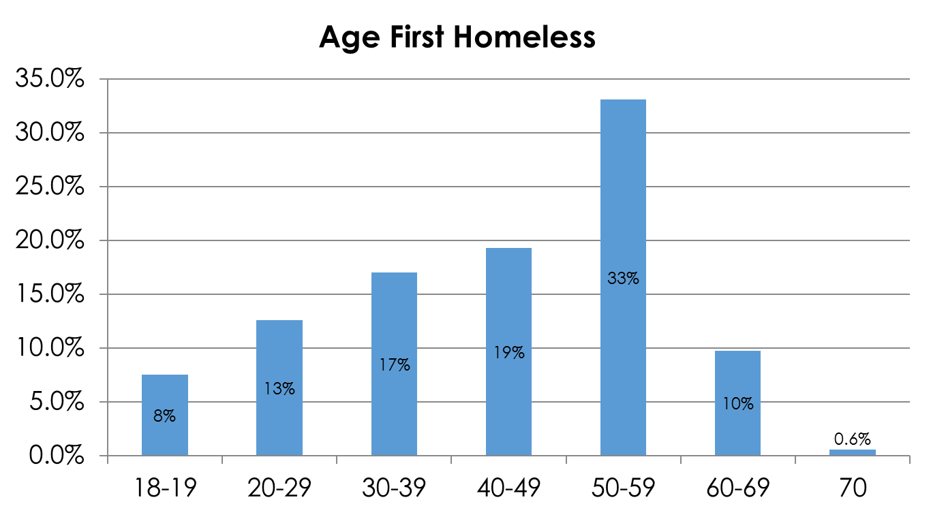
44% with first episode of homelessness after age 50

Slide 20
Almost a third of the sample lost stable housing* in the past year
Years since last stable housing | Percent
<6 months | 18
6 mo to <1 yr | 15
1 yr to <5 yrs | 39
5 yrs to <10 yrs | 14
10+ years | 15
*Defined as non-institutional place that you lived for a year of more

Slide 21
Economic challenges and interpersonal conflict are most common reasons to have left last stable housing
Reason | % of Sample
Couldn't pay rent/mortgage | 28
Rent increased | 2
Lost job | 7
Became sick/disabled | 1
Other bills (not medical) | 1
Someone else stopped paying rent/mortgage | 15
Family abuse/violence | 1
Kicked out (not related to money) | 41
Didn’t get along/asked to leave | 11
Drinking/doing drugs | 4
Evicted | 7
Housemates’ substance use/stealing | 1
Building condemned/destroyed/foreclosed | 6
Other reasons | 21
Moved to new city/more desirable place | 6
Hospital/treatment program | 1
Incarcerated | 4
Conditions were poor | 4

Slide 22
Results: Baseline characteristics and life course experiences by age at first homelessness (n=350)
 | First homelessness before age 50 (n = 198) | First homelessness age 50 or older (n = 152) | P value
Male | 78% | 76% | 0.75
African American White Latino Other | 79% 12% 4% 4% | 80% 9% 6% 4% | 0.76
Less than high school education or GED | 31% | 18% | 0.006
Usual occupation as unskilled labor | 33% | 25% | 0.12
Years of lifetime homelessness, median (IQR) | 4.2 (1.7, 10.0) | 2.0 (0.7, 5.3) | <.001
Homeless for ≥1 year during current episode of homelessness | 73% | 60% | 0.01
Brown RT, Goodman L, Guzman D, Tieu L, Ponath C, Kushel M. Pathways to Homelessness among Older Homeless Adults: Results from the HOPE HOME Study. PLoS One. 2016; 11(5):e0155065. PMID: 27163478.

Slide 23
Baseline characteristics and life course experiences by age at first homelessness (n=350)
 | First homelessness before age 50 (n = 198) | First homelessness age 50 or older (n = 152) | P value
Childhood adverse experiences (<18 years)
Death of caregiver | 21% | 24% | 0.5
Incarceration of caregiver >12 months | 7% | 3% | 0.12
Incarceration in juvenile justice system | 28% | 16% | 0.008
Abuse or neglect | 67% | 55% | 0.02
Verbal abuse | 55% | 41% | 0.01
Physical abuse | 37% | 29% | 0.15
Sexual abuse | 17% | 8% | 0.01
Any chronic medical condition | 13% | 3% | 0.001
Drug use problem | 48% | 32% | 0.002
Brown RT, Goodman L, Guzman D, Tieu L, Ponath C, Kushel M. Pathways to Homelessness among Older Homeless Adults: Results from the HOPE HOME Study. PLoS One. 2016; 11(5):e0155065. PMID: 27163478.

Slide 24
Baseline characteristics and life course experiences by age at first homelessness (n=350)
 | First homelessness before age 50 (n = 198) | First homelessness age 50 or older (n = 152) | P value
Young adulthood (18–25 years)
Imprisoned in a state or federal prison | 59% | 43% | 0.005
Mental health problem | 25% | 15% | 0.02
Alcohol use problem | 48% | 30% | 0.001
Drug use problem | 70% | 54% | 0.003
Middle adulthood (26–49 years)
Underemployed | 54% | 29% | <.001
Traumatic brain injury | 22% | 9% | 0.001
Drug use problem | 75% | 59% | 0.001
Brown RT, Goodman L, Guzman D, Tieu L, Ponath C, Kushel M. Pathways to Homelessness among Older Homeless Adults: Results from the HOPE HOME Study. PLoS One. 2016; 11(5):e0155065. PMID: 27163478.

Slide 25
Reduced Multivariable Model: First homelessness <50 (n=350)
 | Multivariable odds ratio (95% CI)
Young adulthood (18–25 years) experiences
Difficulty paying bills or received government support | 2.9 (1.6–5.5)
Lacked spouse/partner | 2.0 (1.2–3.5)
Mental health problem | 2.0 (1.2–3.5)
Middle adulthood (26–49 years) experiences
Underemployed | 3.0 (1.8–5.1)
Traumatic brain injury | 2.5 (1.2–5.2)
Cumulative experiences over three life periods
Imprisonment | 1.4 (1.1–2.0)
Alcohol use problem | 1.9 (1.3–2.7)
Factors associated with distinct residential patterns in older homeless adults
Brown RT, Goodman L, Guzman D, Tieu L, Ponath C, Kushel M. Pathways to Homelessness among Older Homeless Adults: Results from the HOPE HOME Study. PLoS One. 2016; 11(5):e0155065. PMID: 27163478.

Slide 26
Current vulnerabilities by age at first homelessness (n=350)
 | First homelessness before age 50 (n = 198) | First homelessness age 50 or older (n = 152) | P value
Health status fair or poor | 60% | 50% | 0.06
Mental health status and substance use
Moderate to severe depressive symptoms | 44% | 31% | 0.008
Post-traumatic stress disorder | 39% | 24% | 0.002
Hallucinations in past 6 months | 19% | 8% | 0.003
Psychiatric hospitalization in past 6 mos. | 7% | 2% | 0.03
At-risk drug use | 57% | 42% | 0.006
Functional and cognitive status
ADL impairment | 43% | 34% | 0.07
IADL impairment | 59% | 38% | <0.0001
Brown RT, Goodman L, Guzman D, Tieu L, Ponath C, Kushel M. Pathways to Homelessness among Older Homeless Adults: Results from the HOPE HOME Study. PLoS One. 2016; 11(5):e0155065. PMID: 27163478.

Slide 27
Those with early homelessness (<50)
  More adverse life experiences
  Low income attainment in early adulthood
  No spouse partner
  Mental health problems
  Traumatic brain injury
  Imprisonment
  Alcohol use problem
Brown RT, Goodman L, Guzman D, Tieu L, Ponath C, Kushel MB. Pathways to Homelessness among Older Homeless Adults: Results from the HOPE HOME Study. PLoS One. 2016 May 10;11(5)

Slide 28
I only did like 5-6 months in YA [juvenile justice] when I was 13, but then after that I started getting violations over the years, that’s where the four years [in juvenile justice system] came in at, going back and forth.... Yeah, when I got to be 17 then they took me off....
When I got 21, that’s when I started using drugs...At that time I was doing burglaries and all kind of petty thefts and …I don’t know, back then it was like every ninety days I end up back in San Quentin.
It wasn’t like, “Oh, I can’t wait until I go get high,” or nothing like that, but eventually I got high. Then that one time led to one another and a thousand other too many. So I was in that mentality, trapped in that mentality for over forty years.

Slide 29
(My father said): “Next time you, if you runaway, I’ll beat you with a car chain or I’m going to throw you out the window.”
Okay, so I, I was, I wouldn’t use the word ‘reasonable’ but I put things in perspective real quick and I would say, “Could I survive a car chain? Probably not.”
Then I looked out the window and said, and we lived on the 13th floor, I said, “I ain’t playing with this man.” He went to work, I had whatever I had on me, I was out the door.

Slide 30
Late onset homelessness
Low wage work throughout life
Crisis
  Job loss
  Marital breakdown
  Illness (participant, spouse)
  Death (spouse, parent)

Slide 31
Late onset homelessness
Lack of advocacy
  Evictions for reasons other than non-payment of rent
  Not getting benefits
  Multiple bureaucratic hurdles
Low social support
  Shame prevented them from accessing social support
Less likely to have imprisonment/long incarceration, but housing hampered by one-time charges (i.e. one drug charge) or unexplained arrest

Slide 32
“It was a lot of different things but basically the new owners took over, we were being evicted.
My wife, she had just got out of the hospital, had the stroke and was blind….so, the daughter came up and said, ‘Don’t fight it, y'all can come stay with me for a couple months and save your money.’ So we said, ‘Okay’ ...[and didn’t fight the eviction].
After we moved out of the place, turned in the keys and everything we went over to her house and she said, ‘Y'all can’t stay here.’ And I said, ‘I got $9 in my pocket,’
I said, ‘At least let your mother spend the night because we don’t have enough money to get a motel room.’ She said, ‘No.’ So that was the beginning.”

Slide 33
“…When they bought the company out they cut our hours back and they would bring in temp workers and they would give them all the hours and they weren’t giving us our hours, which caused me to lose my place I was staying in because I couldn’t afford to pay the rent, because, you know, from, you’re going from almost 80-100 (hours) a week down to 20 hours a week, it’s kind of hard to pay bills.”

Slide 34
Yeah, because, all my friends, I’m going to say like 80% of them or 90% of them, they were all working people like me…I was just too ashamed…These were the people who cared….but I, I didn’t look at it that way. I should have.

Slide 35
Conclusions
In cohort of homeless adults 50 and older
  Median age 57
  One-third lost housing in prior year
  Other household member’s loss of income important precipitant
  44% had first episode homelessness after age 50
Life course experiences and current health status differs in those with onset first time homelessness <50 than those ≥50
  More frequent (and severe) adverse early life experiences
  Lower attainment typical milestones early adulthood and middle age

Slide 36
Conclusions
Those with early life homelessness had earlier onset and more severe substance use, mental health problems
Significantly different current vulnerability profiles
  Homeless >50 with fewer substance use problems, fewer mental health problems, better overall health and function
Missed opportunities for prevention for late-life homelessness
  Job loss, death/illness of spouse/partner/parent as key precipitant
  Social isolation/stigma/shame reduce help seeking

Slide 37
Conclusions
While birth cohort at high risk, these data suggest older homeless adults not single cohort
Will need different interventions to prevent and address homelessness

Slide 38

margot.kushel@ucsf.edu
@mkushel

Slide 39
HOPE HOME papers currently available or in press
Brown RT, Goodman L, Guzman D, Tieu L, Ponath C, et al. Pathways to Homelessness among Older Homeless Adults: Results from the HOPE HOME Study. PLoS One. 2016;11(5):e0155065. PubMed PMID: 27163478; PubMed Central PMCID: PMC4862628.
Lee CT, Guzman D, Ponath C, Tieu L, Riley E, et al. Residential patterns in older homeless adults: Results of a cluster analysis. Soc Sci Med. 2016 Mar;153:131-40. PubMed PMID: 26896877; NIHMSID: NIHMS761784; PubMed Central PMCID: PMC4788540.
Vijayaraghavan M, Tieu L, Ponath C, Guzman D, Kushel M. Tobacco Cessation Behaviors Among Older Homeless Adults: Results From the HOPE HOME Study. Nicotine Tob Res. 2016 Aug;18(8):1733-9. PubMed PMID: 26920648; PubMed Central PMCID: PMC4941600.
Spinelli MA, Ponath C, Tieu L, Hurstak EE, Guzman D, et al. Factors associated with substance use in older homeless adults: Results from the HOPE HOME study. Subst Abus. 2017 Jan-Mar;38(1):88-94. PubMed PMID: 27897965; NIHMSID: NIHMS859935; PubMed Central PMCID: PMC5472372.
Raven MC, Tieu L, Lee CT, Ponath C, Guzman D, et al. Emergency Department Use in a Cohort of Older Homeless Adults: Results From the HOPE HOME Study. Acad Emerg Med. 2017 Jan;24(1):63-74. PubMed PMID: 27520382.
Vijayaraghavan M, Olsen P, Weeks J, McKelvey K, Ponath C, et al. Older African American Homeless-Experienced Smokers' Attitudes Toward Tobacco Control Policies-Results from the HOPE HOME Study. Am J Health Promot. 2017 Jan 1;:890117117729928. PubMed PMID: 28893086.
Lee CM, Mangurian C, Tieu L, Ponath C, Guzman D, et al. Childhood Adversities Associated with Poor Adult Mental Health Outcomes in Older Homeless Adults: Results From the HOPE HOME Study. Am J Geriatr Psychiatry. 2017 Feb;25(2):107-117. PubMed PMID: 27544890; NIHMSID: NIHMS811458; PubMed Central PMCID: PMC5253307.

Slide 40
HOPE HOME papers currently available or in press
Brown RT, Hemati K, Riley ED, Lee CT, Ponath C, et al. Geriatric Conditions in a Population-Based Sample of Older Homeless Adults. Gerontologist. 2017 Aug 1;57(4):757-766. PubMed PMID: 26920935.
Landefeld JC, Miaskowski C, Tieu L, Ponath C, Lee CT, et al. Characteristics and Factors Associated With Pain in Older Homeless Individuals: Results From the Health Outcomes in People Experiencing Homelessness in Older Middle Age (HOPE HOME) Study. J Pain. 2017 Sep;18(9):1036-1045. PubMed PMID: 28412229; NIHMSID: NIHMS867699; PubMed Central PMCID: PMC5581208.
Hurstak E, Johnson JK, Tieu L, Guzman D, Ponath C, et al. Factors associated with cognitive impairment in a cohort of older homeless adults: Results from the HOPE HOME study. Drug Alcohol Depend. 2017 Sep 1;178:562-570. PubMed PMID: 28738314; NIHMSID: NIHMS894872; PubMed Central PMCID: PMC5568464.
Patanwala M, Tieu L, Ponath C, Guzman D, Ritchie CS, et al. Physical, Psychological, Social, and Existential Symptoms in Older Homeless-Experienced Adults: An Observational Study of the Hope Home Cohort. J Gen Intern Med. 2017 Nov 28;PubMed PMID: 29185174.
Tong M, Tieu L, Lee CT, Ponath C, Guzman D, Kushel M. Factors associated with food insecurity among older homeless adults: results from the HOPE HOME study. J Public Health (Oxf). 2018 Apr 02. PMID: 29617886.
Sudore RL, Cuervo IA, Tieu L, Guzman D, Kaplan LM, Kushel M. Advance Care Planning for Older Homeless-Experienced Adults: Results from the Health Outcomes of People Experiencing Homelessness in Older Middle Age Study. J Am Geriatr Soc. 2018 May 9. doi: 10.1111/jgs.15417. [Epub ahead of print] PMID: 29741765.
Bazari A, Patanwala M, Kaplan LM, Auerswald CL, Kushel, M. 'The thing that really gets me is the future': Symptomatology in Older Homeless Adults in the HOPE HOME Study. In press. J Pain Symptom Manage.

